Slide 1
Linked Lists

Slide 2
Linked Lists
A linked list is a linear collection of data elements, called nodes, where the linear order is given by means of pointers.
Each node is divided into two parts:
  The first part contains the information of the element and
  The second part contains the address of the next node (link /next pointer field) in the list.

Slide 3
Applications
Linked list is used in a wide variety of applications such as
Polynomial Manipulation representation.
Addition of long positive integers.
Representation of sparse matrices.
Addition of long positive integers.
Symbol table creation.
Mailing list.
Memory management.
Linked allocation of files.

Slide 4
Advantages of Linked Lists
Dynamic size: Linked lists do not have a fixed size, so you can add or remove elements as needed, without having to worry about the size of the list. This makes linked lists a great choice when you need to work with a collection of items whose size can change dynamically.
Efficient Insertion and Deletion: Inserting or deleting elements in a linked list is fast and efficient, as you only need to modify the reference of the next node, which is an O(1) operation.

Slide 5
Advantages of Linked Lists
Memory Efficiency: Linked lists use only as much memory as they need, so they are more efficient with memory compared to arrays, which have a fixed size and can waste memory if not all elements are used.
Easy to Implement: Linked lists are relatively simple to implement and understand compared to other data structures like trees and graphs.
Flexibility: Linked lists can be used to implement various abstract data types, such as stacks, queues, and associative arrays.
Easy to navigate: Linked lists can be easily traversed, making it easier to find specific elements or perform operations on the list

Slide 6
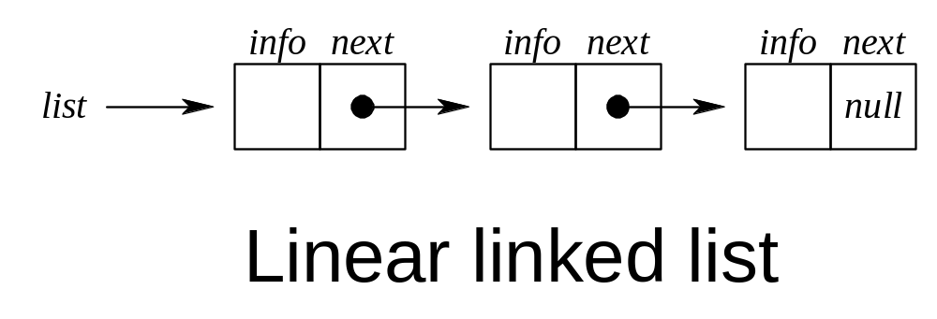
Linked Lists

Slide 7
Types of linked list
Following are the various types of linked list
Simply linked list:
− Item navigation is forward only.
Doubly linked list:
− Items can be navigated forward and backward.
Circular linked list:
− Last item contains link of the first element as next
And the first element has a link to the last element as previous.

Slide 8
Types of linked list
Circular Doubly Linked List: The circular doubly linked list is a combination of the doubly linked list and the circular linked list. It means that this linked list is bidirectional and contains two pointers and the last pointer points to the first pointer.

Slide 9
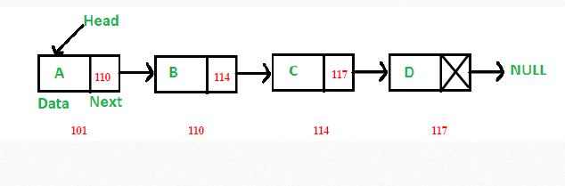
Simply linked list

Slide 10
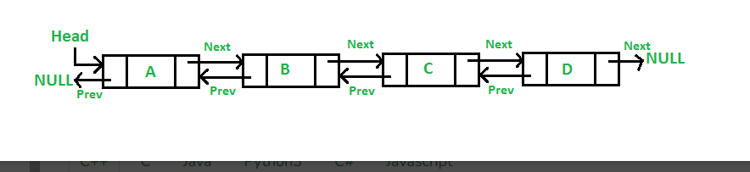
Doubly linked list:

Slide 11
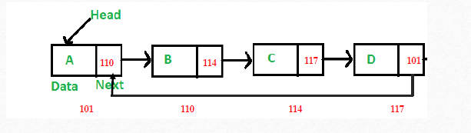
Circular linked list

Slide 12
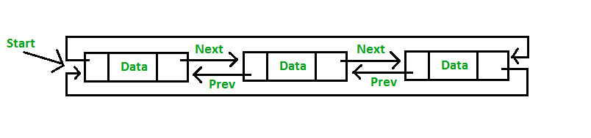
Circular Doubly Linked List

Slide 13
Basic Operations in the Linked Lists
The basic operations in the linked lists are insertion, deletion, searching, display, and deleting an element at a given key. These operations are performed on Singly Linked Lists as given below −
Insertion − Adds an element at the beginning of the list.
Deletion − Deletes an element at the beginning of the list.
Display − Displays the complete list.
Search − Searches an element using the given key.
Delete − Deletes an element using the given key.

Slide 14
Some Notations for use in algorithm (Not in C programs)
p: is a pointer
node(p): the node pointed to by p
info(p): the information portion of the node
next(p): the next address portion of the node
getnode(): obtains an empty node
freenode(p): makes node(p) available for reuse even if the value of the pointer p is changed.

Slide 15
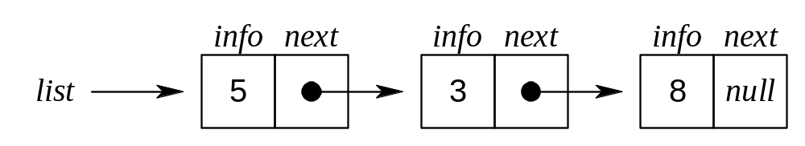
Adding an Element to the front of a Linked List

Slide 16
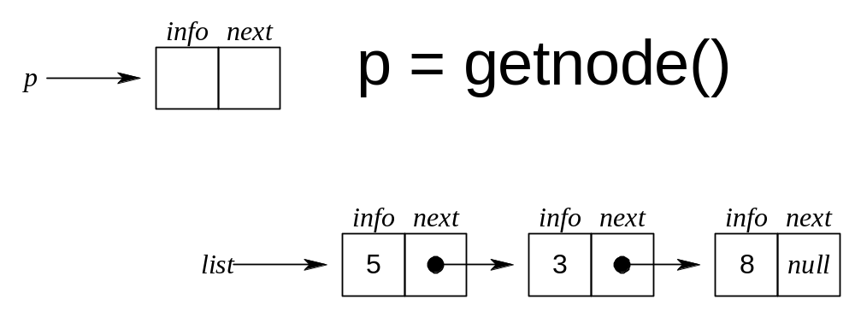
Adding an Element to the front of a Linked List

Slide 17
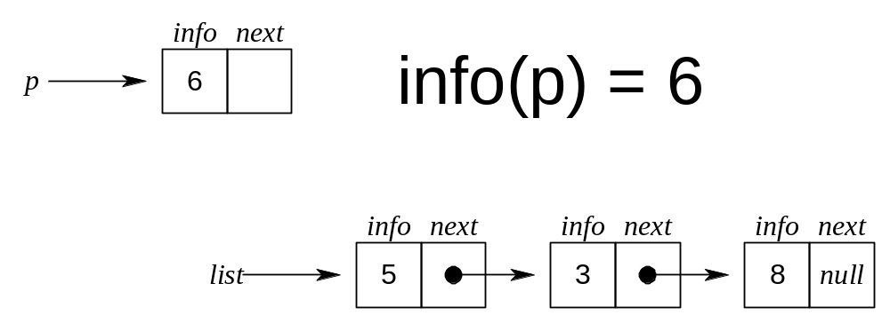
Adding an Element to the front of a Linked List

Slide 18
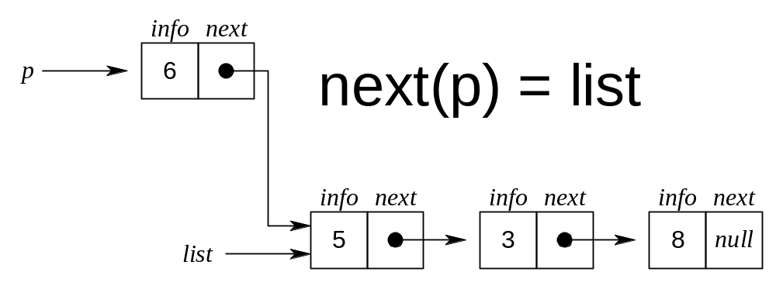
Adding an Element to the front of a Linked List

Slide 19
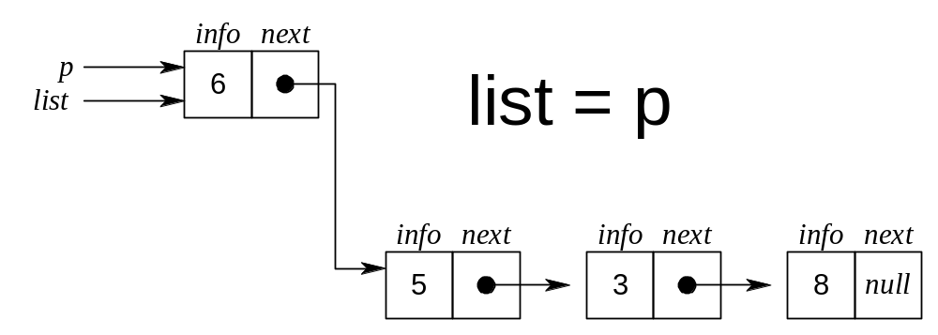
Adding an Element to the front of a Linked List

Slide 20
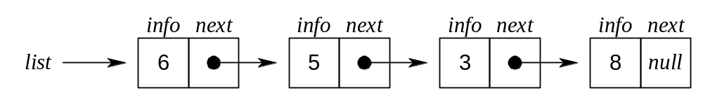
Adding an Element to the front of a Linked List

Slide 21
Removing an Element from the front of a Linked List

Slide 22
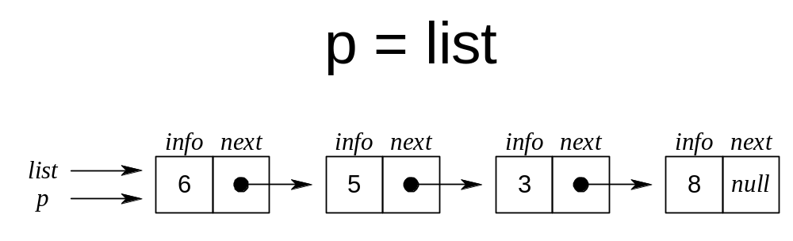
Removing an Element from the front of a Linked List

Slide 23
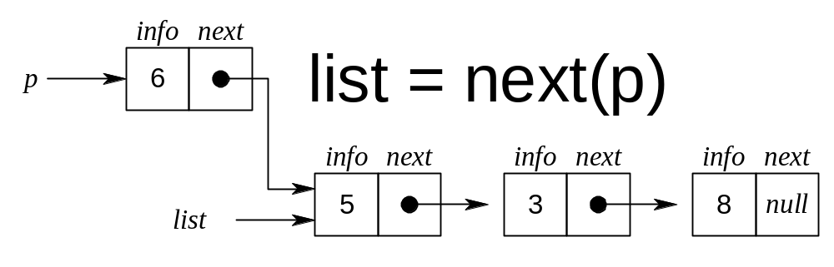
Removing an Element from the front of a Linked List

Slide 24
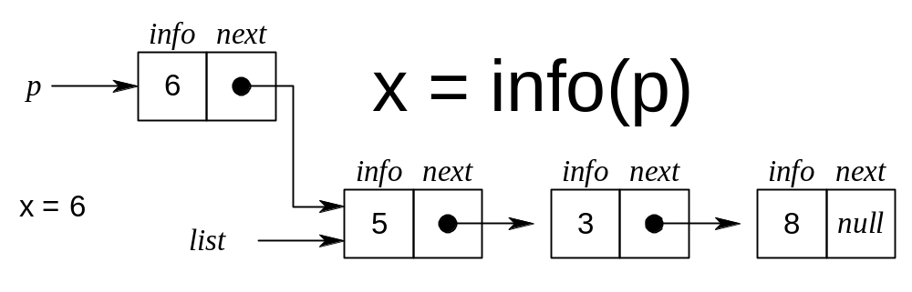
Removing an Element from the front of a Linked List

Slide 25
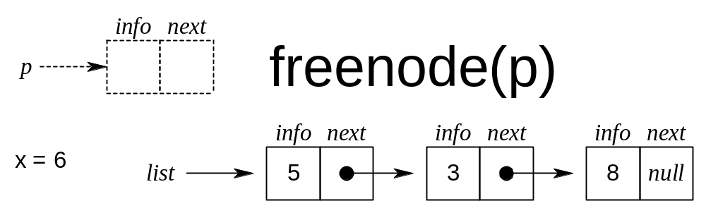
Removing an Element from the front of a Linked List

Slide 26
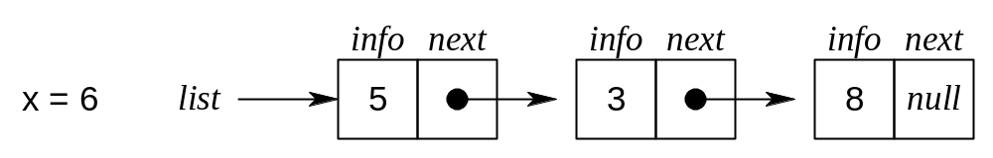
Removing an Element from the front of a Linked List

Slide 27
Linked List Implementation of Stacks – PUSH(S,X)
The first node of the list is the top of the stack. If an external pointer s points to such a linked list, the operation push(s,x) may be implemented by
    p=getnode();
    info(p)=x;
    next(p)=s;
    s=p;

Slide 28
Linked List Implementation of Stacks – POP(S)
The operation x=pop(s) removes the first node from a nonempty list and signals underflow if the list is empty:
    if (empty(s)){ /* checks whether s equals null */
    printf(‘stack underflow’);
    exit(1);
    }
    else {
    p =s;
    s=next(p);
    x = info(p);
    freenode(p);
    }

Slide 29
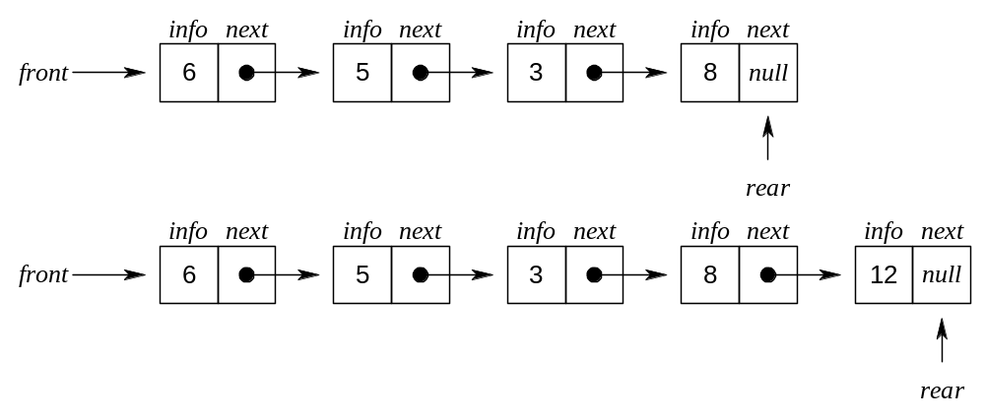
Linked List Implemantation of QUEUES

Slide 30
Linked List Implemantation of QUEUES
A queue q consists of a list and two pointers, q.front and q.rear. The operations empty(q) and x=remove(q) are completely analogous to empty(s) and x=pop(s), with the pointer q.front replacing s.
  if(empty(q)){
  printf(“queue undeflow”);
  exit(1);
  }
  p=q.front;
  x=info(p);
  q.front=next(p);
  if(q.front==null)
  q.rear=null;
  freenode(p);
  return(x);

Slide 31
Linked List Implemantation of QUEUES
The operation insert(q,x) is implemented by
  p= getnode();
  info(p)=x;
  next(p)=null;
  if(q.front==null)
  q.front=p;
  else
  next(q.rear)=p;
  q.rear=p;

Slide 32
Linked List as a Data Structure
An item is accesses in a linked list by traversing the list from its beginning.
An array implementation allows acccess to the nth item in a group using single operation, whereas a list implementation requires n operations.
The advantage of a list over an array occurs when it is necessary to insert or delete an element in the middle of a group of other elements.

Slide 33
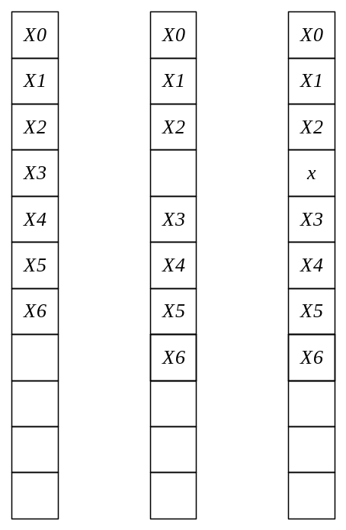
Element x is inserted between the third an fourth elements in an array

Slide 34
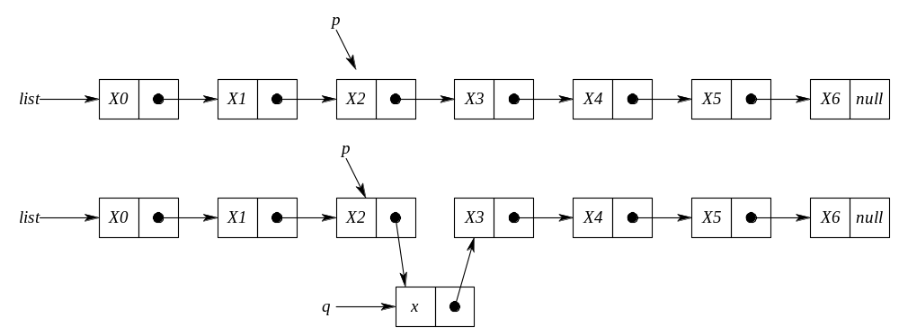
Inserting an item x into a list after a node pointed to by p

Slide 35
Inserting an item x into a list after a node pointed to by p
q=getnode();
info(q)=x;
next(q)=next(p);
next(p)=q;

Slide 36
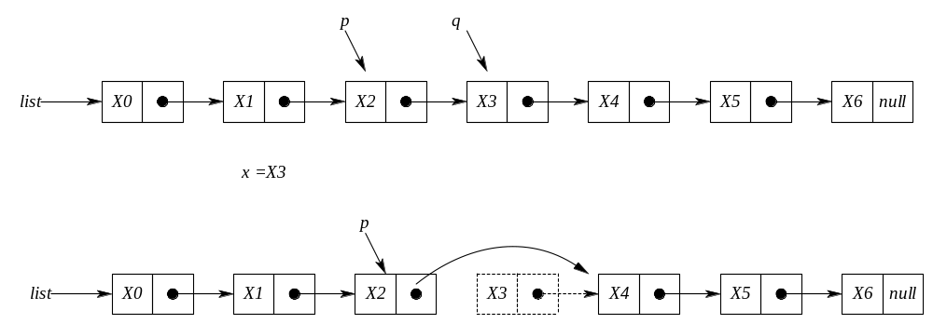
Deleting an item x from a list after a node pointed to by p

Slide 37
Deleting an item x from a list after a node pointed to by p
q=next(p);
x=info(q);
next(p)=next(q);
freenode(q);

Slide 38
LINKED LISTS USING DYNAMIC VARIABLES
In array implementation of the linked lists a fixed set of nodes represented by an array is established at the beginning of the execution
A pointer to a node is represented by the relative position of the node within the array.
In array implementation, it is not possible to determine the number of nodes required for the linked list. Therefore;
  Less number of nodes can be allocated which means that the program will have overflow problem.
  More number of nodes can be allocated which means that some amount of the memory storage will be wasted.
The solution to this problem is to allow nodes that are dynamic, rather than static.
When a node is required storage is reserved/allocated for it and when a node is no longerneeded, the memory storage is released/freed.

Slide 39
ALLOCATING AND FREEING DYNAMIC VARIABLES
C library function malloc() is used for dynamically allocating a space to a pointer. Note that the malloc() is a library function in <stdlib.h> header file.
The following lines allocate an integer space from the memory pointed by the pointer p.
  int *p;
  p = (int *) malloc(sizeof(int));
  Note that sizeof() is another library function that returns the number of bytes required for the operand. In this example, 4 bytes for the int.

Slide 40
ALLOCATING AND FREEING DYNAMIC VARIABLES
Allocate floating point number space for a float pointer f.
  float *f;
  f = (float *) malloc(sizeof(float));

Slide 41
Question:What is the output of the following lines?
  int *p, *q;
  int x;
  p = (int *) malloc(sizeof(int));
  *p = 3;
  x = 6;
  q = (int *) malloc(sizeof(int));
  *q=x;
  printf(“%d %d \n”, *p, *q);
The above lines will print 3 and 6.
p
p
3
x
6
q
q
6

Slide 42





malloc() and free()
The following lines and the proceeding figure shows the effectiveness of the free() function.
int *p, *q;
p = (int *) malloc(sizeof(int));
*p = 5;
q = (int *) malloc(sizeof(int));
*q = 8;
free(p);
p = q;
q = (int *) malloc(sizeof(int));
*q = 6;
printf(“%d %d \n”, *p, *q);

Slide 43
LINKED LISTS STRUCTURES AND BASIC FUNCTIONS
The value zero can be used in a C program as the null pointer. You can use the following line to declare the NULL constant. Note that a NULL pointer is considered NOT to point any storage location.
#define NULL 0
The following node structure can be used to implement Linked Lists. Note that the info field, which can be some other data type (not necessarily int), keeps the data of the node and the pointer next links the node to the next node in the Linked List.
struct node{
int info;
struct node *next;
};
typedef struct node *NODEPTR;

Slide 44
LINKED LISTS STRUCTURES AND BASIC FUNCTIONS
When a new node is required (e.g. to be inserted into the list) the following function, getnode, can be used to make a new node to be available for the list.
NODEPTR getnode(void)
{
NODEPTR p;
p = (NODEPTR) malloc(sizeof(struct node));
return p;
}

Slide 45
LINKED LISTS STRUCTURES AND BASIC FUNCTIONS
When a new node is no longer used (e.g. to be deleted from the list) the following function, freenode, can be used to release the node back to the memory.
void freenode(NODEPTR p)
{
free(p);
}

Slide 46
PRIMITIVE FUNCTIONS FOR LINEAR LINKED LISTS
The following functions insertafter(p,x) and delafter(p,px) are primitive functions that can be used for the dynamic implementation of a linked list. Assume that list is a pointer variable pointing the first node of a list (if any) and equals NULL in the case of an empty list.

Slide 47
void insertafter(NODEPTR p, int x)
{
NODEPTR q;
if(p == NULL){
printf("void insertion\n");
exit(1);
}
q=getnode();
q->info = x;
q->next = p->next;
p->next = q;
}

Slide 48
void delafter(NODEPTR p , int *px)
{
NODEPTR q;
if((p == NULL) || (p->next == NULL)){
printf("void deletion\n");
exit(1);
}
q = p->next;
*px = q->info;
p->next = q->next;
freenode(q);
}

Slide 49
Searching through the linked list.
The following function searches through the linked list and returns a pointer the first occurrence of the search key or returns NULL pointer if the search key is not in the list. Note that the linked list contains integer data items.

Slide 50
NODEPTR searchList(NODEPTR plist, int key)
{
  NODEPTR p;
  p = plist;
  while(p != NULL){
    if(p->info == key)
      return p;
    p = p->next;
  }
  return NULL;
}

